Slide 1
CSS EXTRA

Slide 2
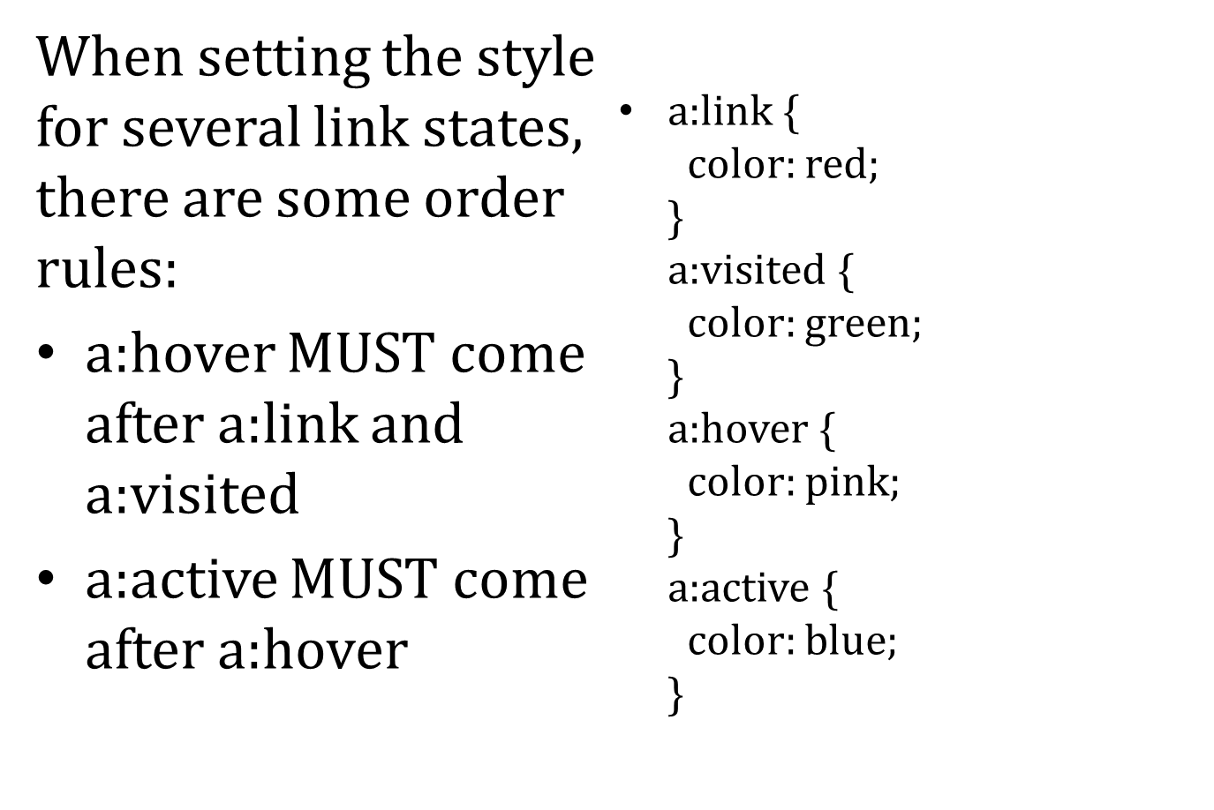

Slide 3
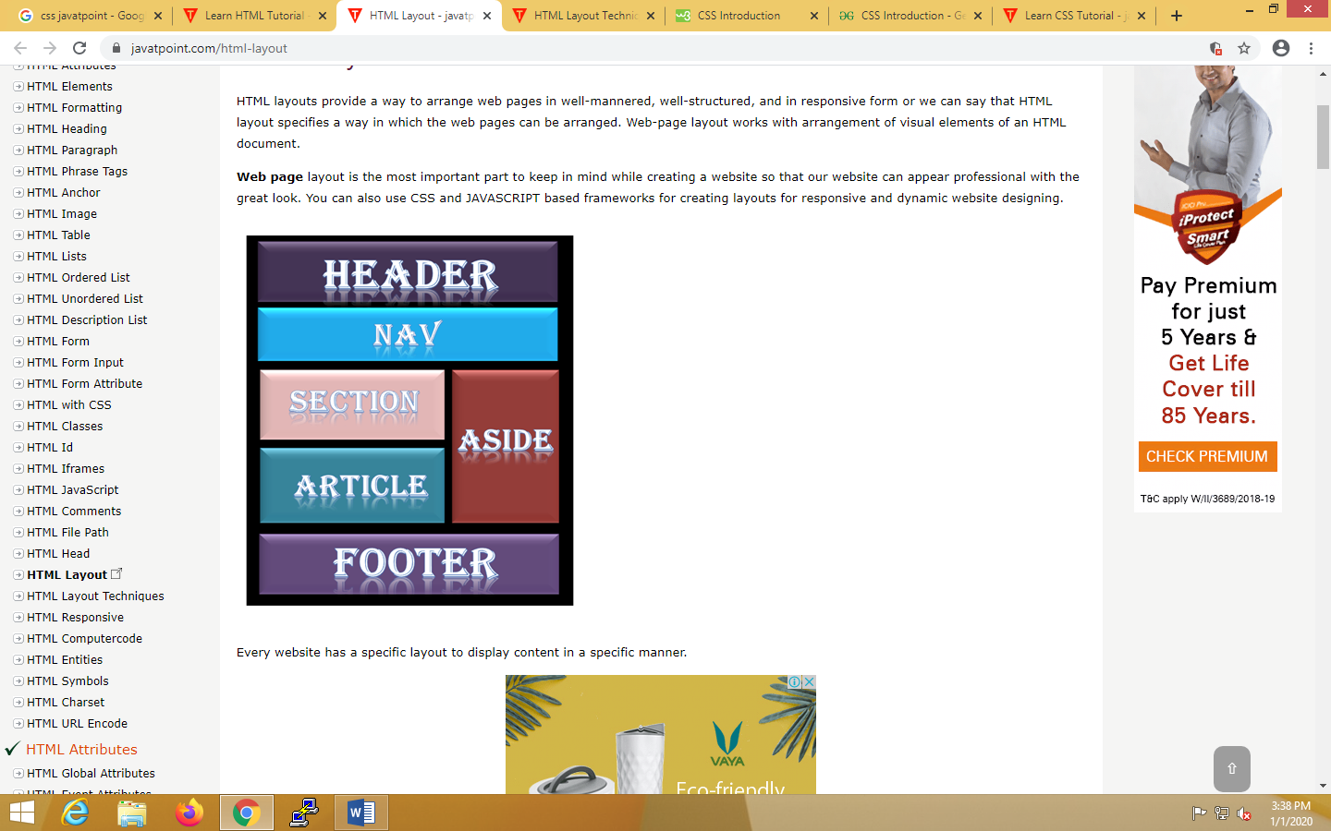
HTML Layouts
HTML layouts provide a way to arrange web pages in well-mannered, well-structured, and in responsive form or we can say that HTML layout specifies a way in which the web pages can be arranged.
Every website has a specific layout to display content in a specific manner

Slide 4
Following are different HTML5 elements which are used to define the different parts of a webpage.
<header>: It is used to define a header for a document or a section.
<nav>: It is used to define a container for navigation links
<section>: It is used to define a section in a document
<article>: It is used to define an independent self-contained article
<aside>: It is used to define content aside from the content.
<footer>: It is used to define a footer for a document or a section
<details>: It is used to define additional details
<summary>: It is used to define a heading for the <details> element

Slide 5
HTML Layout Techniques
HTML tables
CSS float property
CSS framework
CSS flexbox
Layout using div

Slide 6
CSS Table
Properties that are widely used in designing table using CSS:
border
border-collapse
padding
width
height
text-align
color
background-color

Slide 7
Float
<html>
<head> <link rel="stylesheet" type="text/css" href="style.css"> </head> <body> <div id="green"></div>
<div id ="red"></div>
<div id="blue"></div> </body> </html>
style.css
  #green
  {
  width: 200px; height: 200px; border: 1px solid green; float: left; margin: 5px; }
  #red
  {
  width: 100px; height: 200px; border: 1px solid red; margin: 5px; float: left;
  }
  #blue
  {
  width: 310px; height: 100px; border: 1px solid blue; margin: 5px; clear: both;
  }

Slide 8
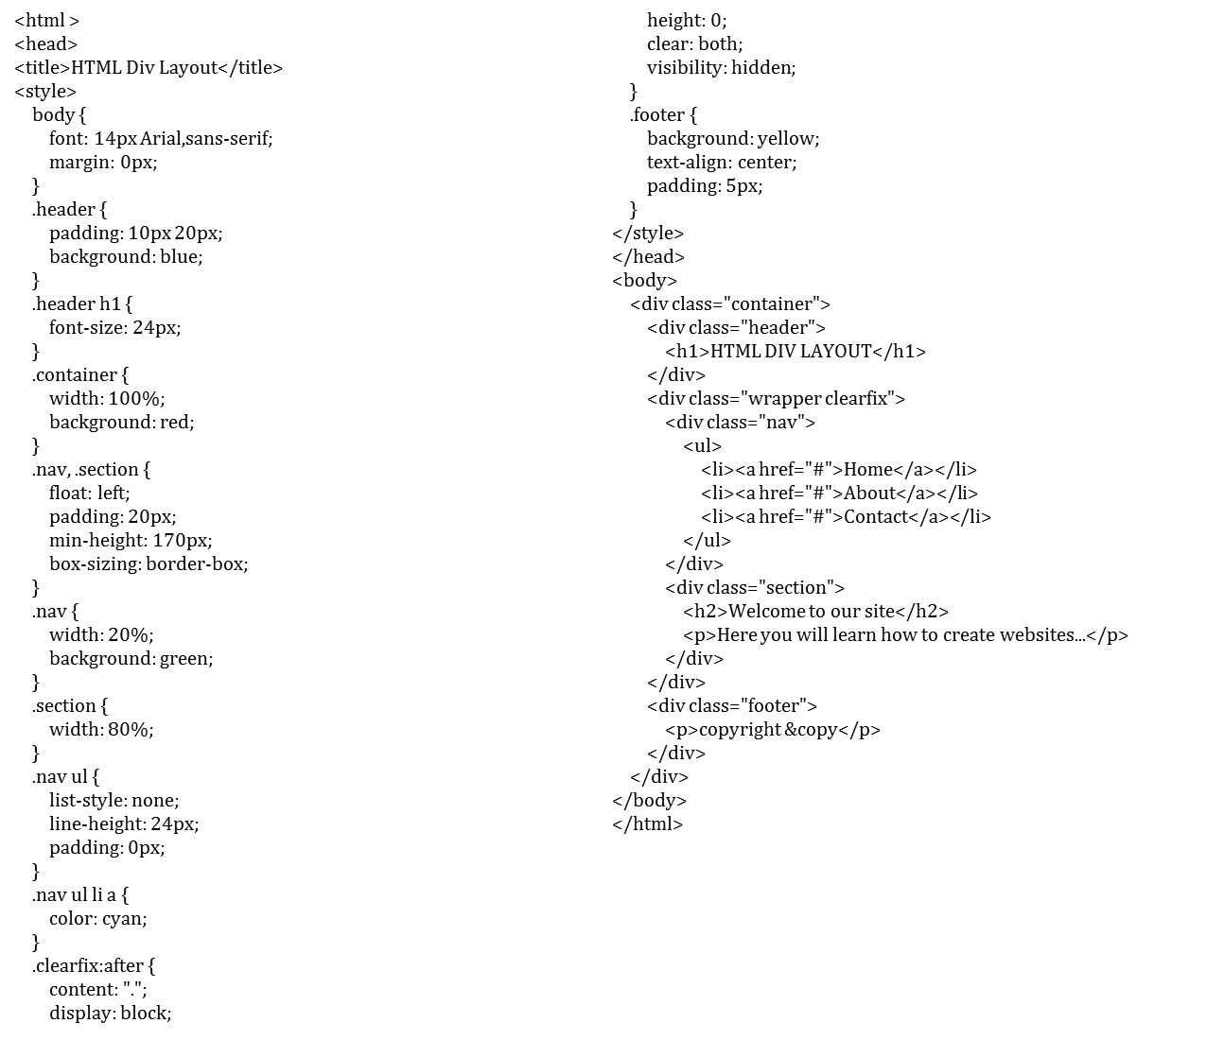

Slide 9
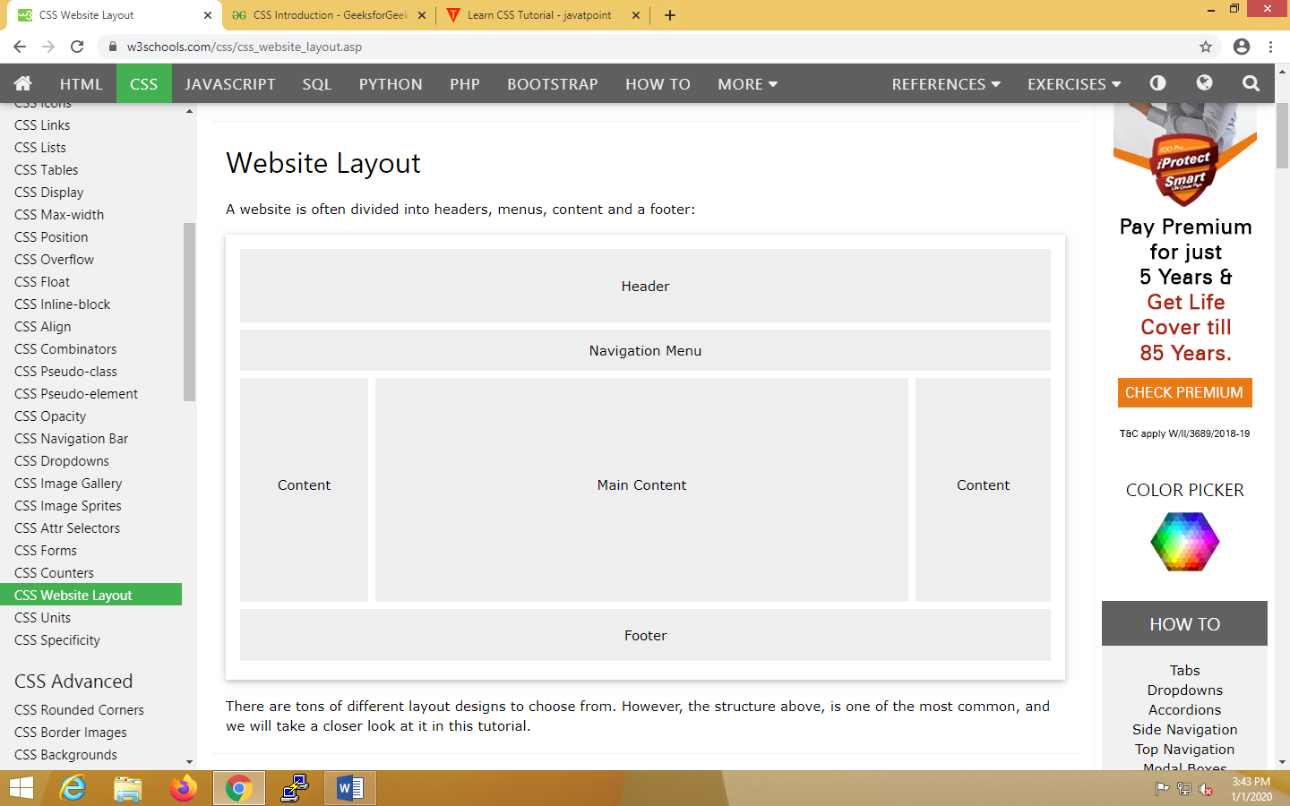

Slide 10
Header
A header is usually located at the top of the website (or right below a top navigation menu). It often contains a logo or the website name:
Example:
  .header {
  background-color: blue;
  text-align: center;
  padding: 20px;
  }
Footer
The footer is placed at the bottom of your page. It often contains information like copyright and contact info:
Example
  .footer {
  background-color: Red;
  text-align: center;
  padding: 10px;
  }

Slide 11
Navigation Bar
A navigation bar contains a list of links to help visitors navigating through your website:
Example
  /* The navbar container */
  .topnav {
  overflow: hidden;
  background-color: blue;
  }
  /* Navbar links */
  .topnav a {
  float: left;
  display: block;
  color: red;
  text-align: center;
  padding: 14px 16px;
  text-decoration: none;
  }
  /* Links - change color on hover */
  .topnav a:hover {
  background-color: yellow;
  color: black;
  }

Slide 12
Content
The layout in this section, often depends on the target users. The most common layout is one (or combining them) of the following:
1-column (often used for mobile browsers)
2-column (often used for tablets and laptops)
3-column layout (only used for desktops)
/* Create three equal columns that floats next to each other */
.column {
float: left;
width: 33.33%;
}
/* Clear floats after the columns */
.row:after {
content: "";
display: table;
clear: both;
}
/* Responsive layout - makes the three columns stack on top of each other instead of next to each other on smaller screens (600px wide or less) */
@media screen and (max-width: 600px) {
.column {
width: 100%;
}
}

Slide 13
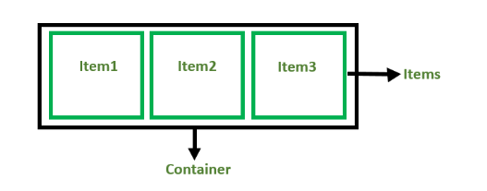
CSS flexbox
Flexbox is a layout mechanism designed for laying out groups of items in one dimension.
There are 2 main components of the Flexbox:
  Flex Container: The parent “div” which contains various divisions is called a flex container.
  Flex Items: The items inside the container “div” are flex items.

Slide 14
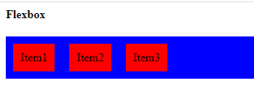
Creating a flex container
<html>
<head>
<style>
.flex-container {
display: flex;
background-color: blue;
}
.flex-container div {
background-color: red;
margin: 10px;
padding: 10px;
}
</style></head>
<body><h4> Flexbox</h4>
<div class="flex-container">
<div>Item1</div>
<div>Item2</div>
<div>Item3</div>
</div></body></html>

Slide 15
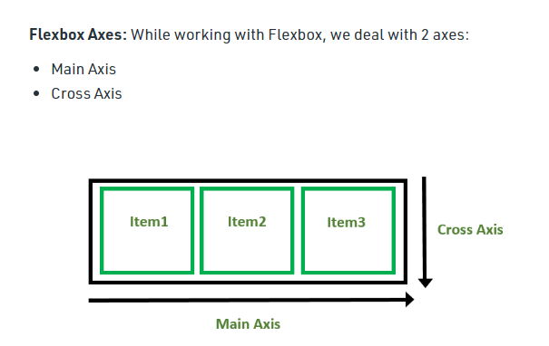
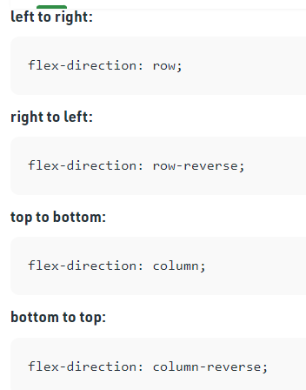

Slide 16
CSS Text Formatting
CSS text formatting include following properties:
1.Text-color
2.Text-alignment
3.Text-decoration
4.Text-transformation
5.Text-indentation
6.Letter spacing
7.Line height
8.Text-direction
9.Text-shadow
10.Word spacing

Slide 17
CSS 2D Transforms Methods
CSS transforms allow you to translate, rotate, scale, and skew elements.
A transformation is an effect that lets an element change shape, size and position.
CSS supports 2D and 3D transformations.
  translate( )
  rotate( )
  scale( )
  skewX( )
  skewY( )
  matrix( )

Slide 18
The translate() method moves an element from its current position (according to the parameters given for the X-axis and the Y-axis).
Example:
<html><head><style>
div {
width: 300px;
height: 100px;
background-color: yellow;
border: 1px solid black;
transform: translate(50px,100px);
}
</style></head>
<body>
<h1>The translate( ) Method</h1>
<p>The translate( ) method moves an element from its current position:</p>
<div>
This div element is moved 50 pixels to the right, and 100 pixels down from its current position.
</div>
</body></html>

Slide 19
The rotate() method rotates an element clockwise or counter-clockwise according to a given degree.
Using negative values will rotate the element counter-clockwise.
Example
<html><head><style>
div {
transform: rotate(20deg);}
</style></head>
<body>
<h1>The rotate( ) Method</h1>
<p>The rotate( ) method rotates an element clockwise or counter-clockwise.</p>
<div>
This div element is rotated clockwise 20 degrees.
</div></body></html>

Slide 20
The scale( ) method increases or decreases the size of an element (according to the parameters given for the width and height).
The scaleX( ) method increases or decreases width of an element.
The scaleY( ) method increases or decreases height of an element.
The skew( ) method skews an element along the X-axis or Y-axis by the given angle
The skewX( ) method skews an element along the X-axis by the given angle.
The skewY( ) method skews an element along the Y-axis by the given angle.

Slide 21
The matrix( ) Method
The matrix( ) method combines all the 2D transform methods into one.
The matrix( ) method take six parameters, containing mathematic functions, which allows you to rotate, scale, move (translate), and skew elements:
The parameters are as follow: matrix(scaleX( ), skewY( ), skewX( ), scaleY( ), translateX( ), translateY( ))
Example
div {
transform: matrix(1, -0.3, 0, 1, 0, 0);
}

Slide 22
CSS 3D Transforms
3D transformation methods:
rotateX( )
  The rotateX( ) method rotates an element around its X-axis at a given degree.
rotateY( )
  The rotateY( ) method rotates an element around its Y-axis at a given degree
rotateZ( )
  The rotateZ( ) method rotates an element around its Z-axis at a given degree.

Slide 23
HTML <nav> Tag
<html><body>
    <nav>
    <a href="/html/">HTML</a>
    <a href="/css/">CSS</a>
    </nav>
    </body></html>
HTML <figcaption> Tag
<figure>
    <img src="img_pulpit.jpg" alt="The Pulpit Rock" width="304" height="228">
    <figcaption>Fig.1 - A view of the pulpit rock in Norway.</figcaption>
    </figure>
HTML <progress> Tag
<html><body>
    Downloading progress:
    <progress value="22" max="100">
    </progress>
    </body></html>

Slide 24
CSS SHADOW EFFECTS
Text-shadow
h1 {
text-shadow: 2px 2px;
}
//add color to shadow
h1 {
text-shadow: 2px 2px red;
}
//To blur the shadow effect
h1 {
text-shadow: 2px 2px 5px red;
}

Slide 25
Box Shadow
Applies shadow to elements
div {
box-shadow: 10px 10px;
}
//add color to shadow
div {
box-shadow: 10px 10px grey;
}
//add blur effect
div {
box-shadow: 10px 10px 5px grey;
}

Slide 26
CSS filter
CSS filters are used to set visual effects to text, images, and other aspects of a webpage.
The CSS filter property allows us to access the effects such as color or blur, shifting on the rendering of an element before the element gets displayed.
Syntax
filter: none | invert( ) | drop-shadow( ) | brightness( )
| saturate( ) | blur( ) | hue-rotate( ) | contrast( ) | opacity( )
| grayscale( ) | sepia( ) | url( );

Slide 27
<style>
body{
text-align:center;
}
#img1 {
filter: brightness(130%);
}
</style>

